Slide 1
GTOR DAQ Shop Space
8/30/2020

Slide 2
COVID Related Items

Slide 3
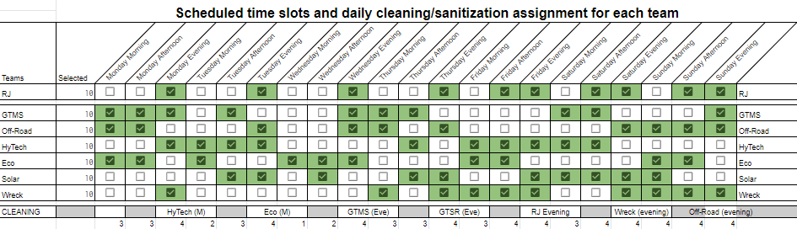
Can’t go into the SCC without permission!
In order to go into the SCC to work on stuff, you need to have explicit approval from me (I then have to get approval from team leads)
Can only go to SCC on scheduled timeslots

Slide 4
Join the #covid19-operations
This is in the SCC slack channel, if you are not already in this slack, you should join sccgt.slack.com
Any updates should be posted here (should probably check this channel for info before coming into the shop)

Slide 5
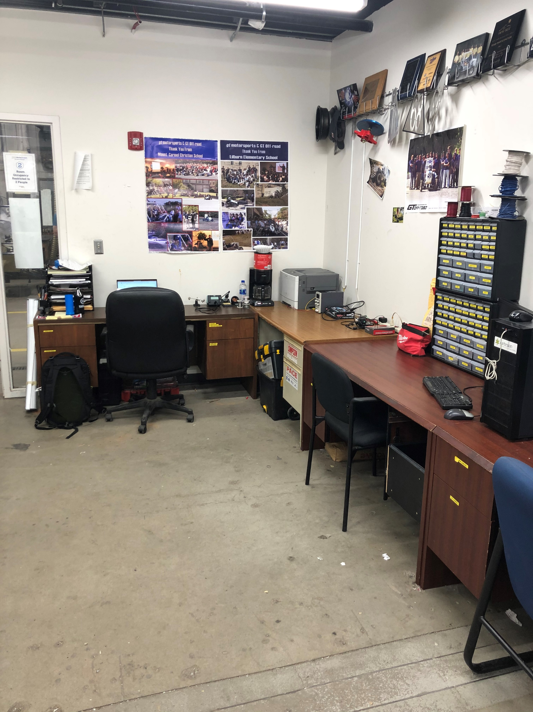
We are now in office
No more sitting upstairs in the heat… Yay!
Max occupancy in office 2 people
This means that really only two DAQ people are allowed in SCC at a time
Must stay 6ft apart in office (or wear face shields if you are required to be within 6ft of someone, such as them helping you solder)
2 people sitting here is 6ft apart

Slide 6
Going into the SCC
Must have the NOVID app installed and running in background (search “NOVID” in app store)
Must be wearing facemask at all times
There is a table of PPE/cleaning supplies across from Hytech’s shop space (to the left of our shop space)
There is a hand sanitizing station right outside of our office

Slide 7
Non-COVID Related Items

Slide 8
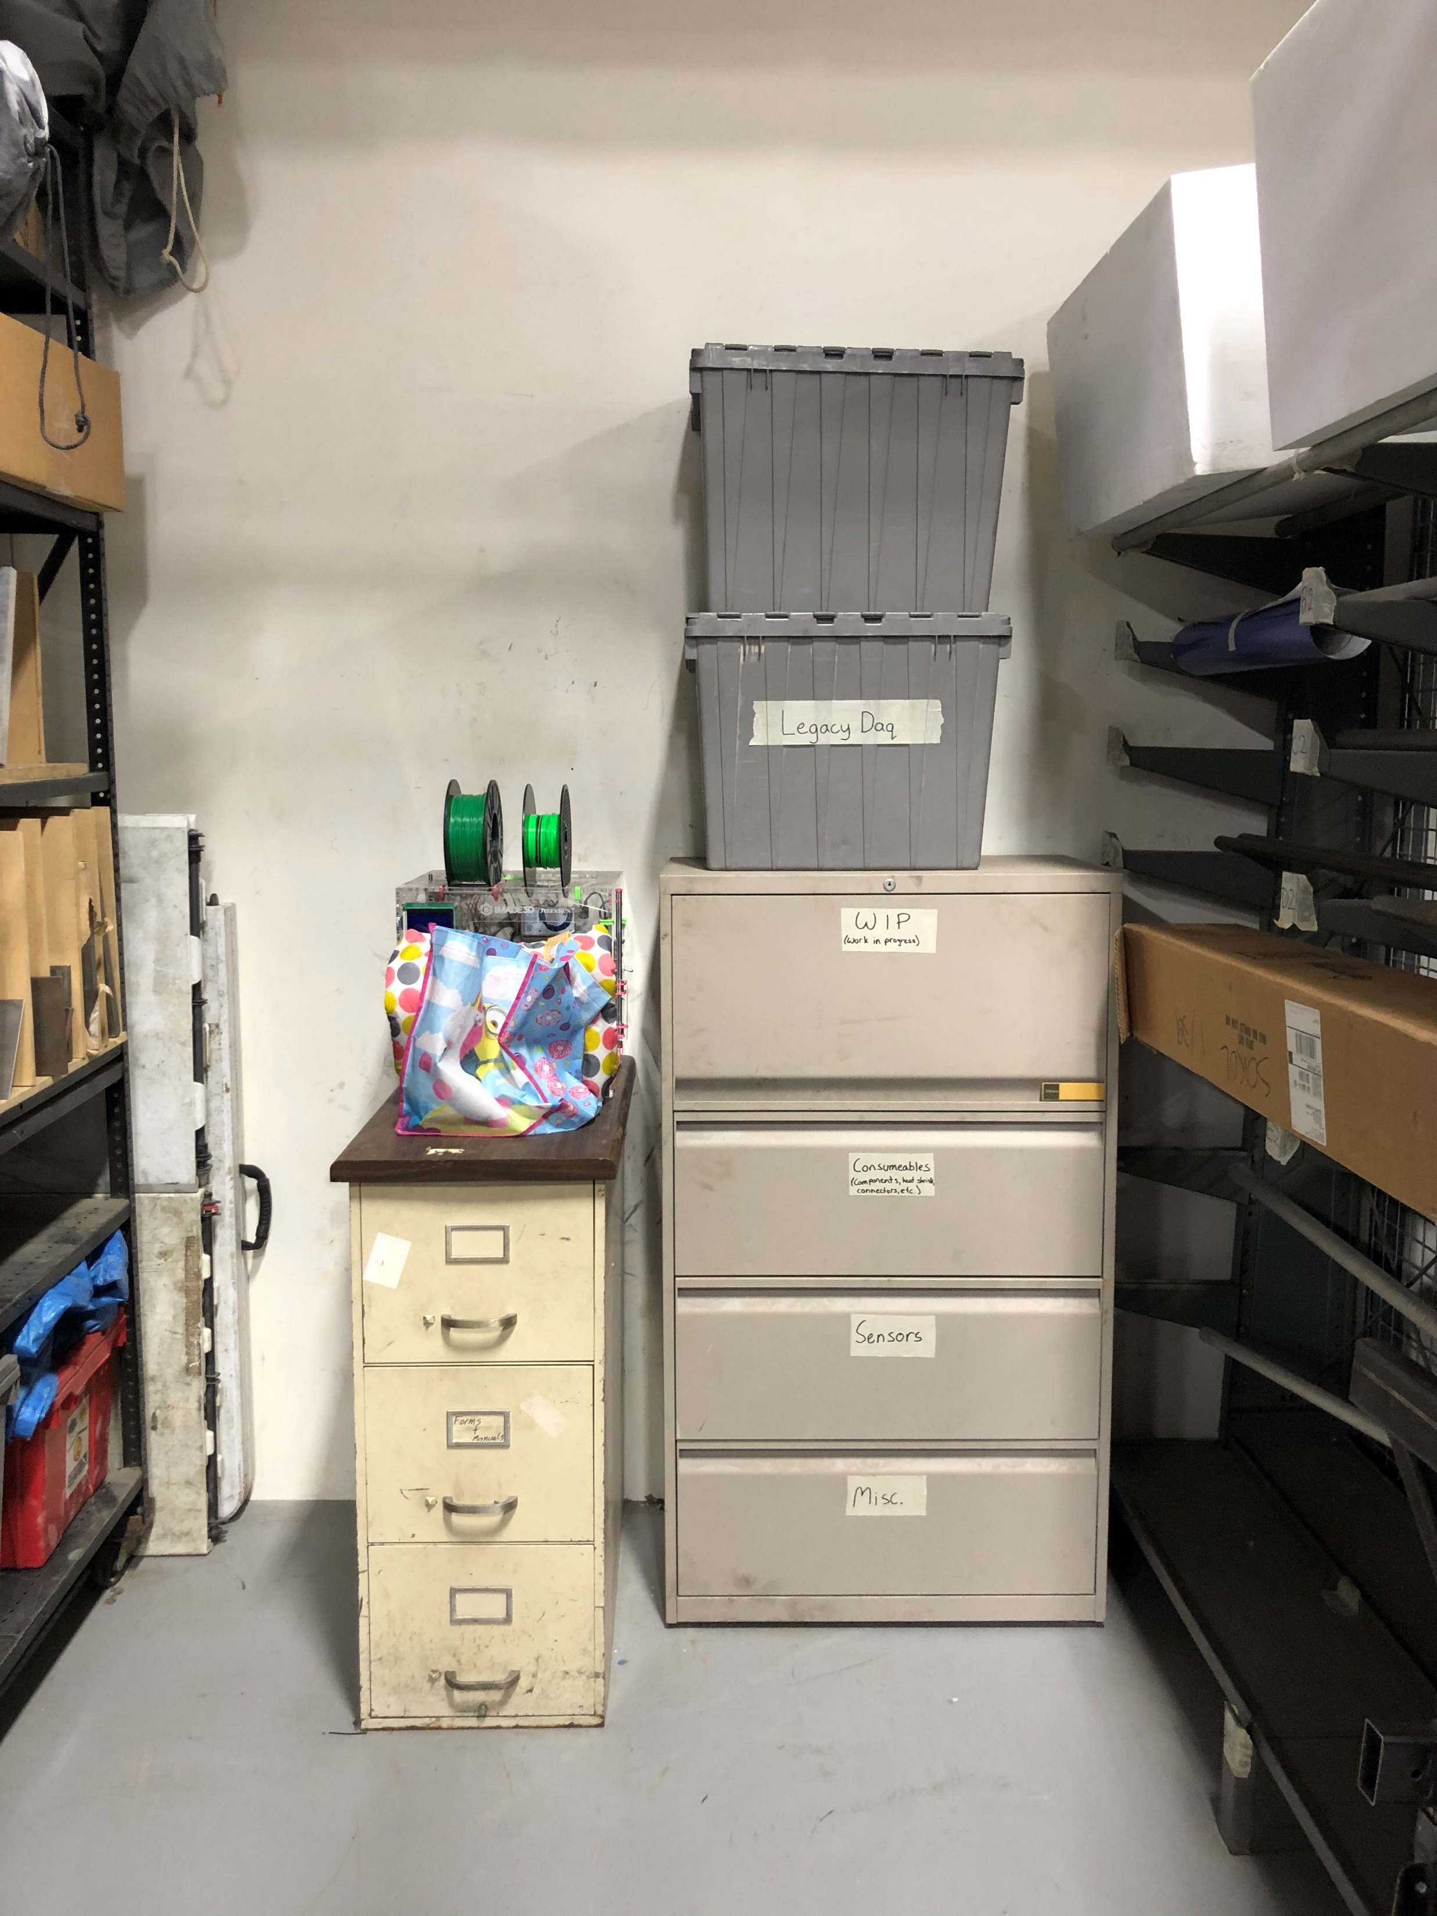
Upstairs cage
Everything in red box is our stuff

Slide 9
Legacy DAQ
Everything in this tote is legacy DAQ stuff
Old daq units
A bunch of 6” tall 8-segment displays (could be useful for something)
Old brakelights, killswitches, etc.
Probably wont need to use this for anything

Slide 10
WIP (work in progress)
Projects that are a work in progress can go in this top shelf so that you can easily get to it and so it doesn’t get lost/broken

Slide 11
Consumables
Larger consumables go in this shelf
Heat shrink
Zip ties
Connectors
Bags/ESD Protection bags
Misc. components

Slide 12
Sensors
Larger sensors go in here
LDS
Load cells
IMU’s / Accelerometers
HE sensors / tone wheels
Misc.

Slide 13
Misc.
Misc. items go in bottom drawer
Right now there isn’t really anything important in there

Slide 14
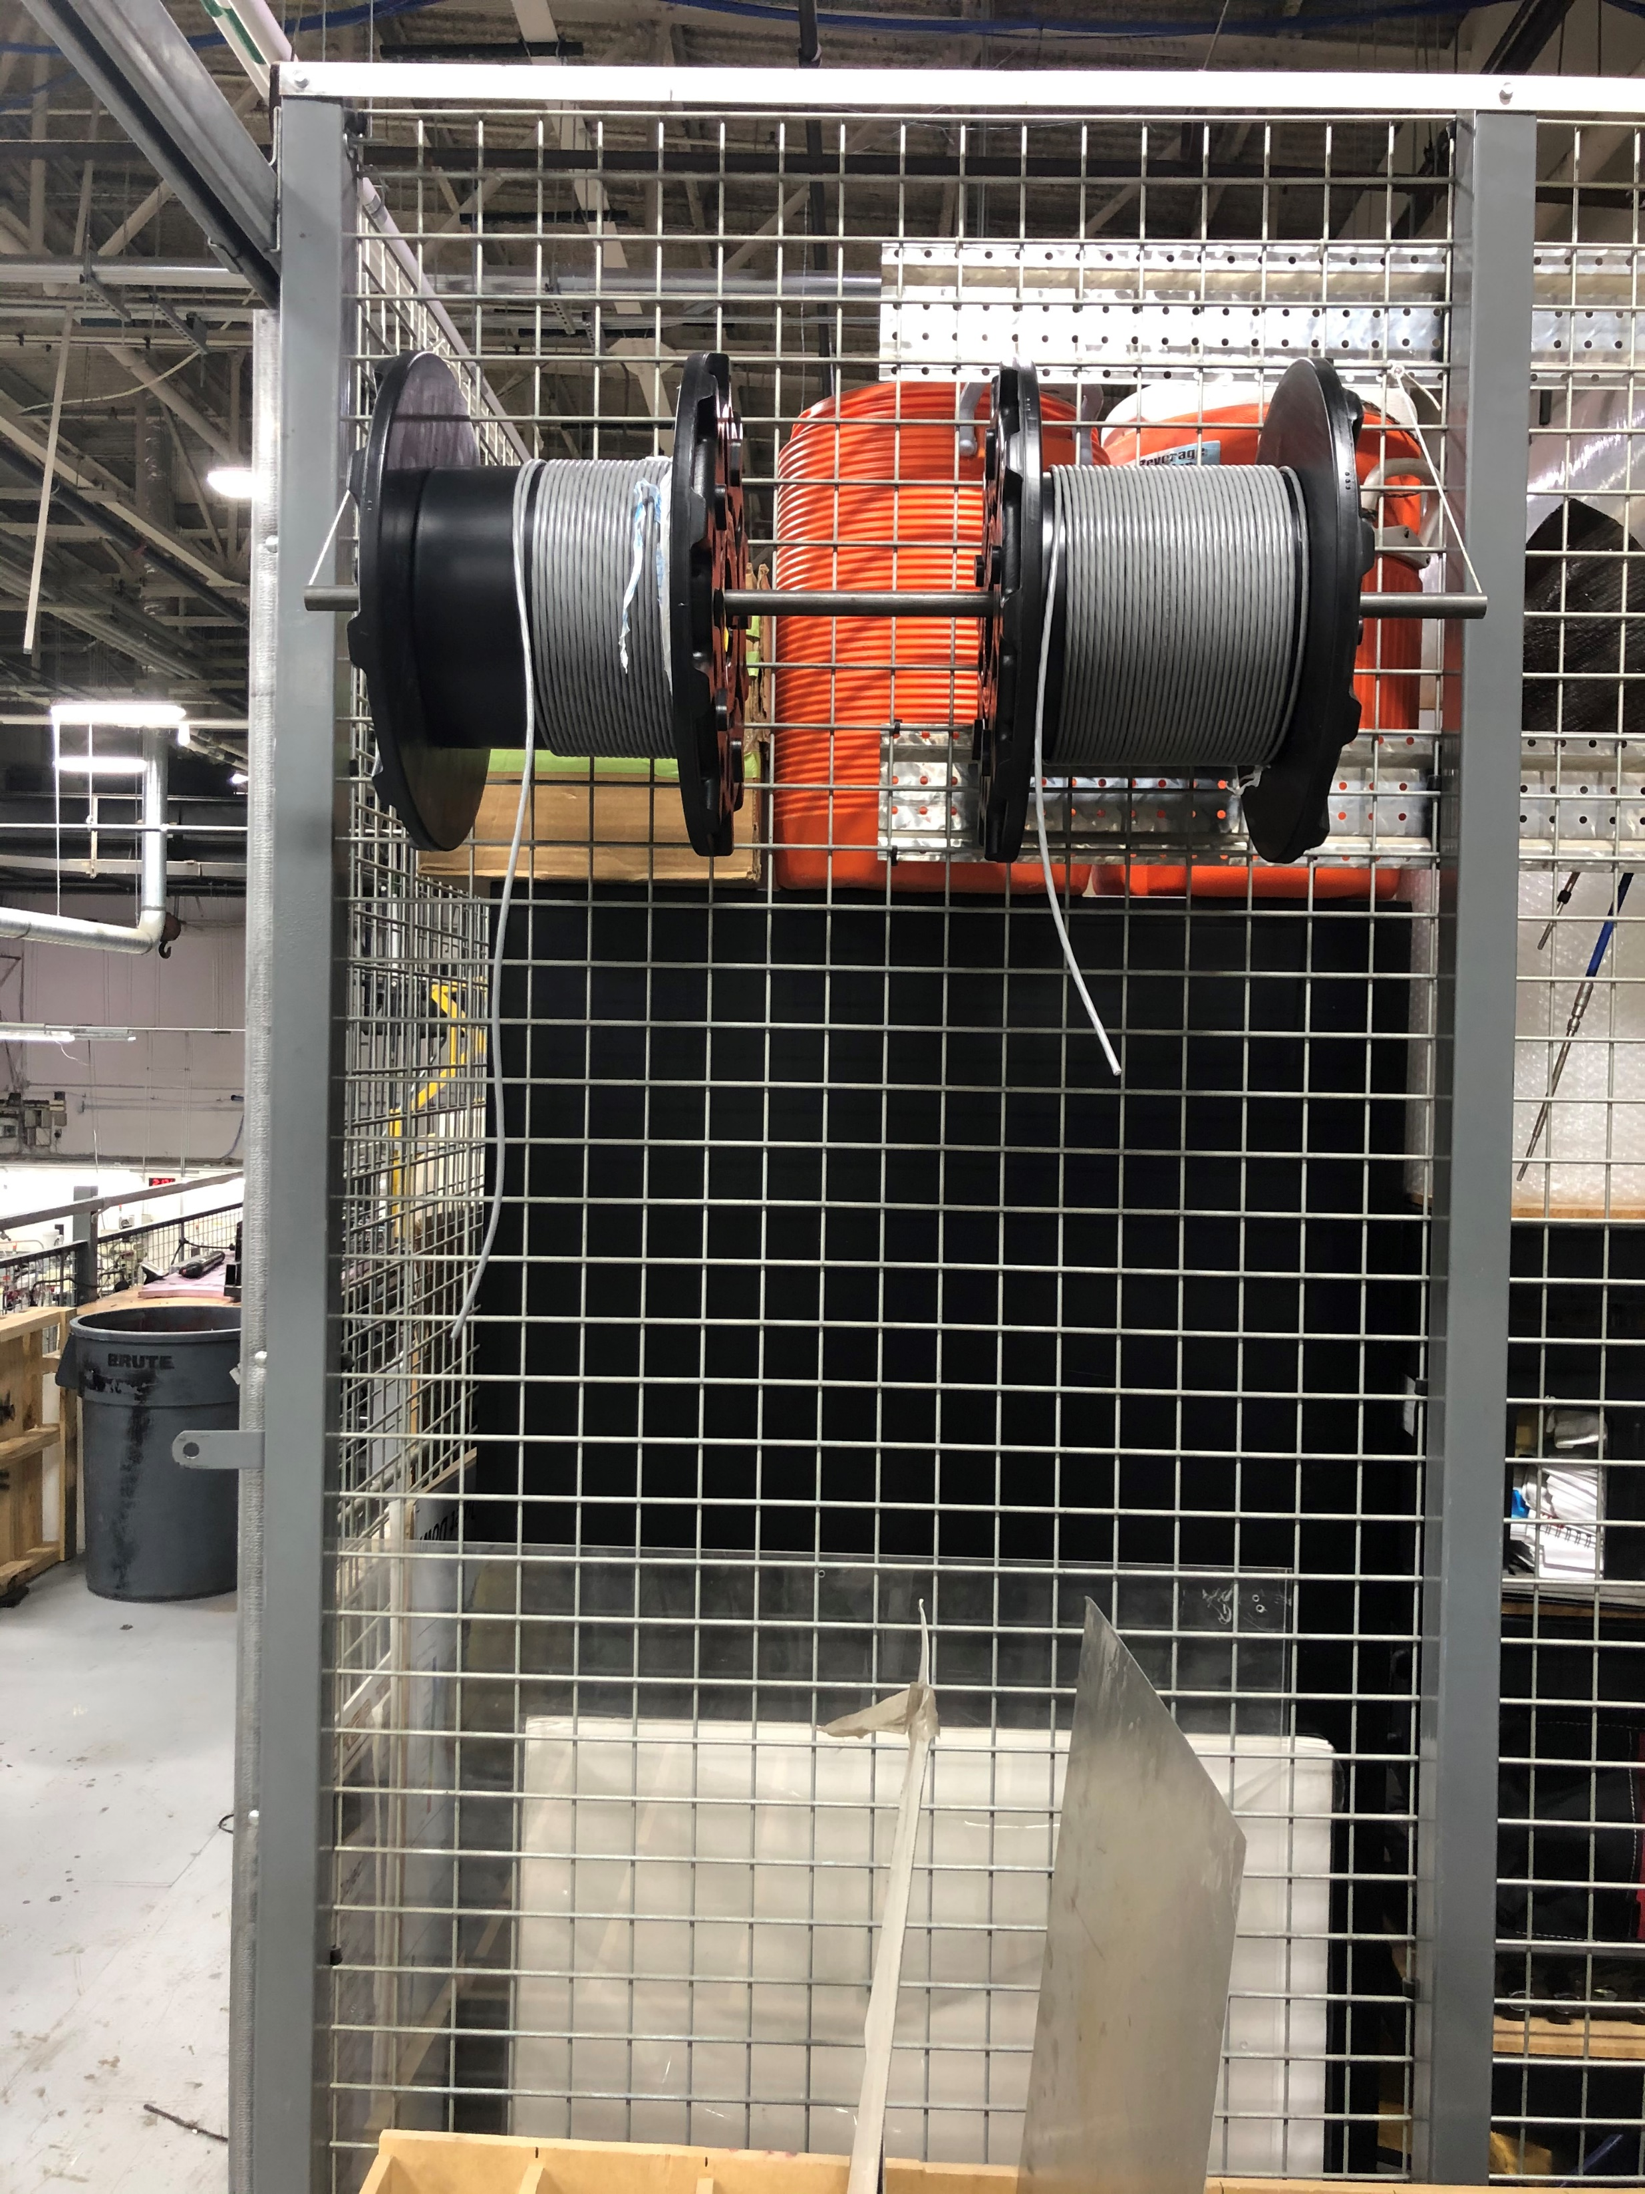
Upstairs cage (wire)
Wire is hanging in the cage on the left
Currently designing better rack to hold this wire
4 more big spools of wire are ordered and are on the way

Slide 15
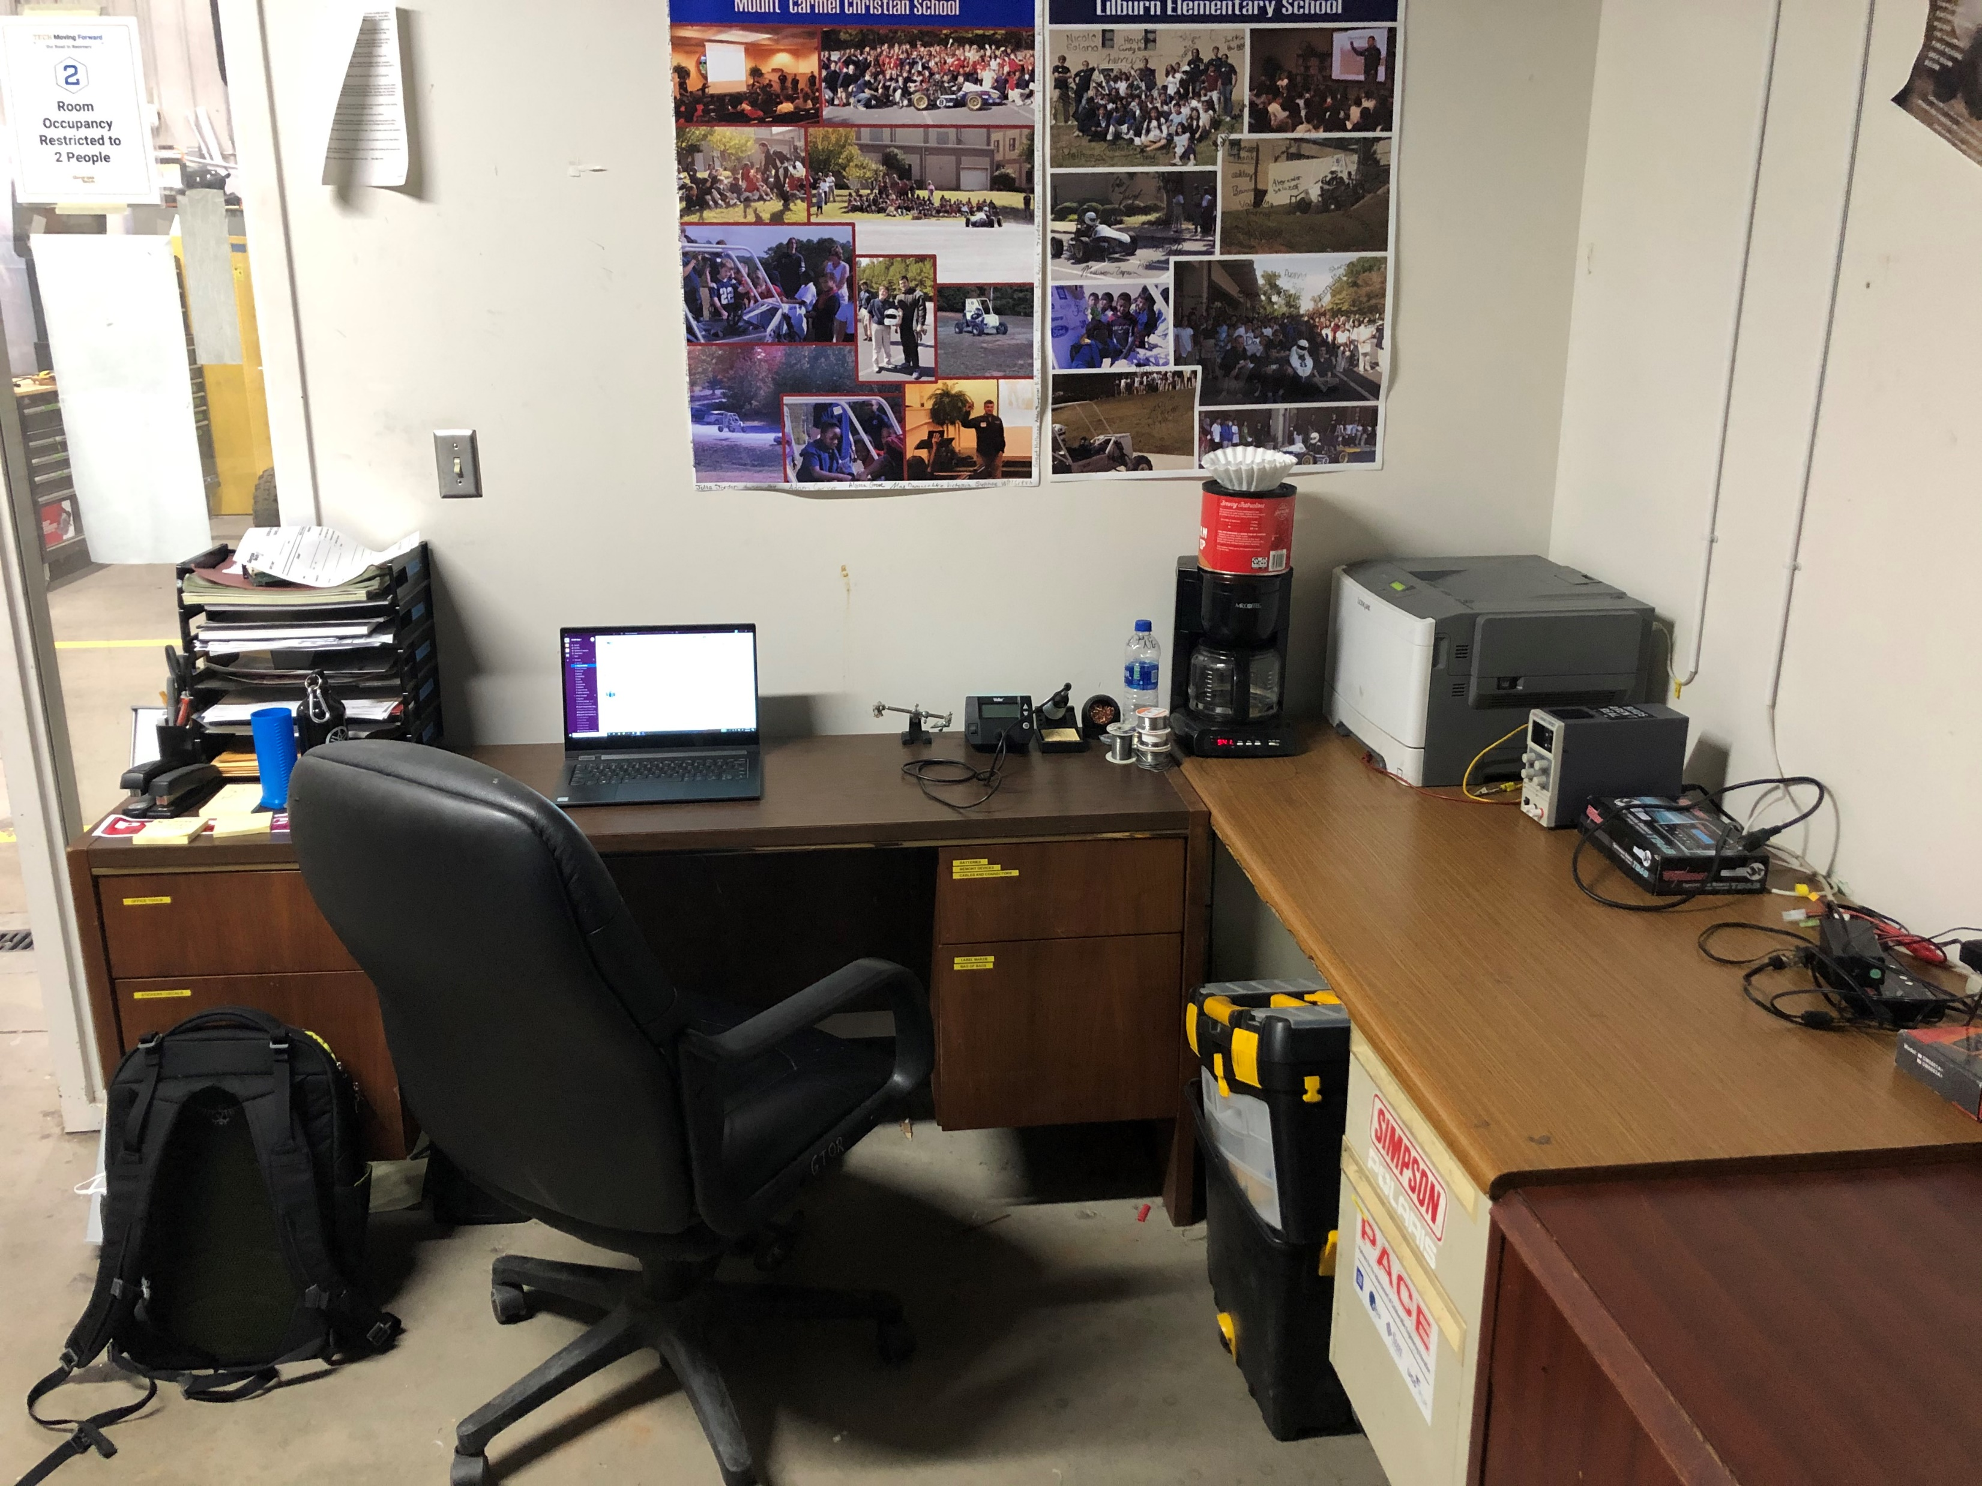
Office (left)
This desk space is dedicated to soldering / working with sensitive electronics
Or just general work on laptop
Try to keep this desk as clean as possible

Slide 16
Office (left)
This desk space is for whatever
There is a power supply here to use
It is okay to leave projects here (if it is sensitive, put it upstairs)

Slide 17
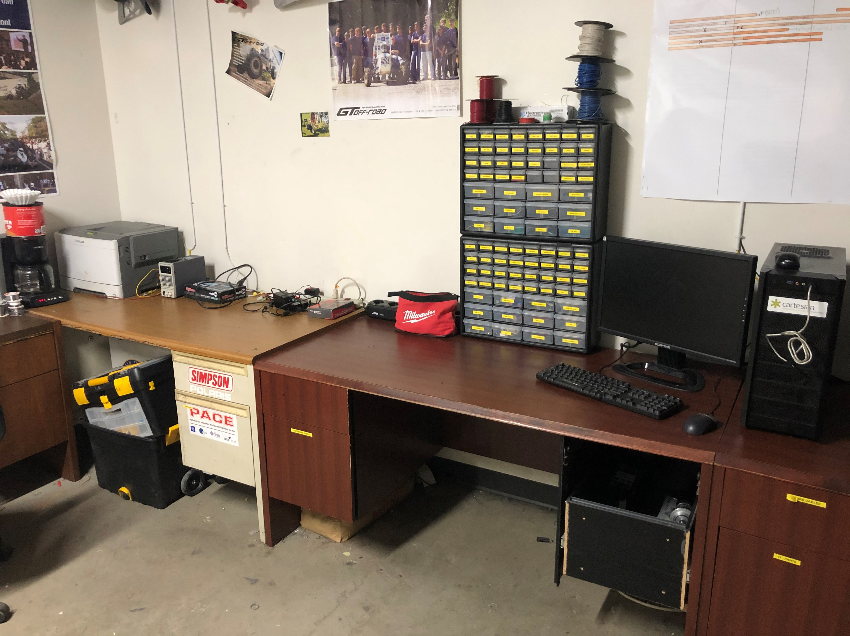
Office (right)
General storage (everything is clearly labeled)
DAQ tools (like small screwdrivers, wire strippers, cutters, etc.)
Misc. storage (I’d like to get a better one soon, clearly it isn’t in great condition lol)
Desktop to use. I think password is Bajanewsae1 or Bajanewsae2 but I’m not sure

